Slide 1
1. Executive Summary The purpose of this document is to outline the business requirements for the development of a new e-commerce website for ABC Retail. The website will enable ABC Retail to expand its market reach and provide a seamless online shopping experience for its customers.

Slide 2
2. Business Objectives
Increase online sales by 30% within the first year of launch.
Enhance customer satisfaction through an improved user interface and user experience.
Streamline order processing and inventory management.

Slide 3
3. Project Scope - In Scope
Design and development of the e-commerce website.
Integration with payment gateways.
User account management.
Product catalog management.
Order processing and tracking.
Inventory management.
Customer support features (e.g., live chat, FAQ).

Slide 4
3. Project Scope - Out of Scope
Physical delivery of products.
Marketing and SEO strategies post-launch.
Offline sales systems integration.

Slide 5
4. Functional Requirements
User Registration and Login
Users shall be able to register with an email address and password.
Users shall be able to log in using their email and password.
Product Catalog Management
Admins shall be able to add, update, and delete products.
Products shall have categories, descriptions, prices, and images.
Shopping Cart
Users shall be able to add products to a shopping cart.
Users shall be able to view and modify the contents of their shopping cart.
Checkout Process
Users shall be able to proceed to checkout.
The system shall support multiple payment methods (credit card, PayPal, etc.).
Order Management
Users shall receive order confirmation emails.
Admins shall be able to view and manage orders.
Customer Support
Users shall have access to a live chat feature.
Users shall be able to view an FAQ section.

Slide 6
5. Non-Functional Requirements
Performance
The website shall load within 3 seconds under normal traffic conditions.
Security
The website shall use HTTPS for all transactions.
User data shall be encrypted.
Scalability
The website shall support up to 10,000 concurrent users.
Reliability
The website shall have an uptime of 99.9%.

Slide 7
6. Stakeholders
Project Sponsor: Jane Smith, CFO, ABC Retail
Project Manager: John Doe, IT Manager, ABC Retail
Developers: XYZ Software Solutions
End Users: Customers of ABC Retail

Slide 8
7. Assumptions
Users have access to the internet.
Payment gateways will provide necessary APIs for integration.
Inventory data is maintained accurately by the business.

Slide 9
8. Constraints
The project must be completed within 4 months.
The budget for the project is $50,000.

Slide 10
9. Risks
Technical Risk: Integration with payment gateways might be more complex than anticipated.
Operational Risk: Delays in content creation (product descriptions, images) may impact the project timeline.
Market Risk: Competitor actions may affect the expected increase in online sales.

Slide 11
Glossary
API: Application Programming Interface.
HTTPS: HyperText Transfer Protocol Secure.
Uptime: The time during which the website is operational and available.

Slide 12
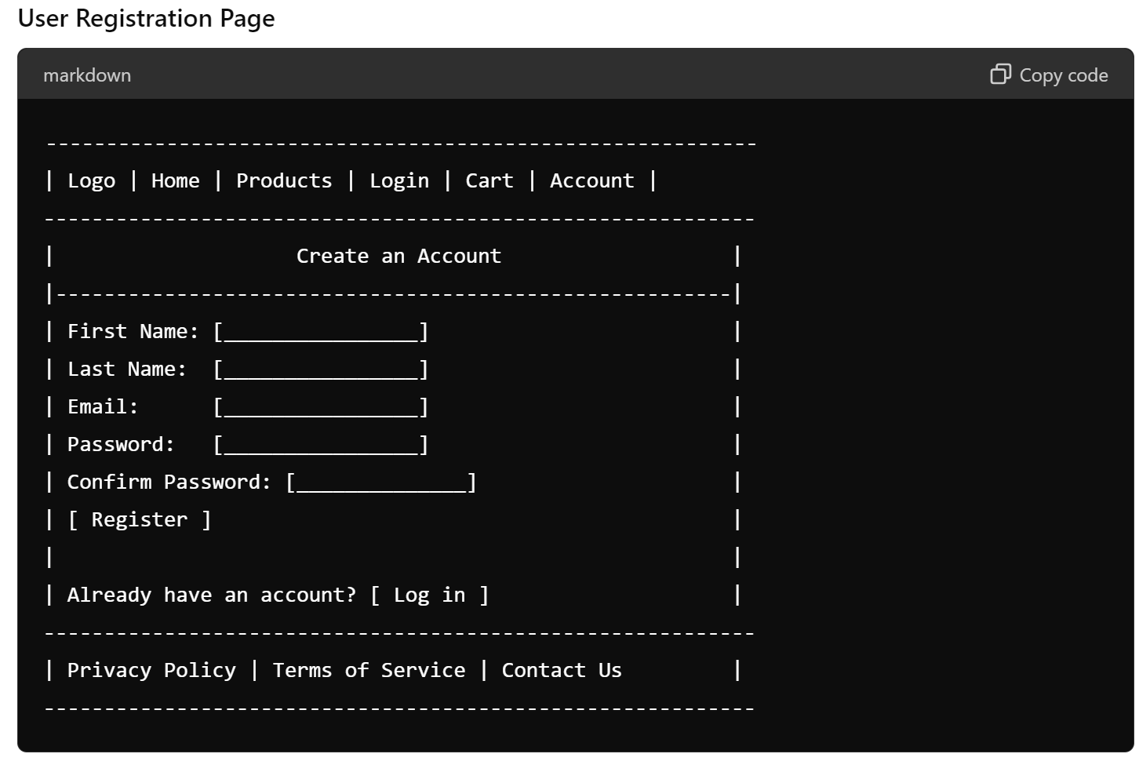
User Registration and Login

Slide 13
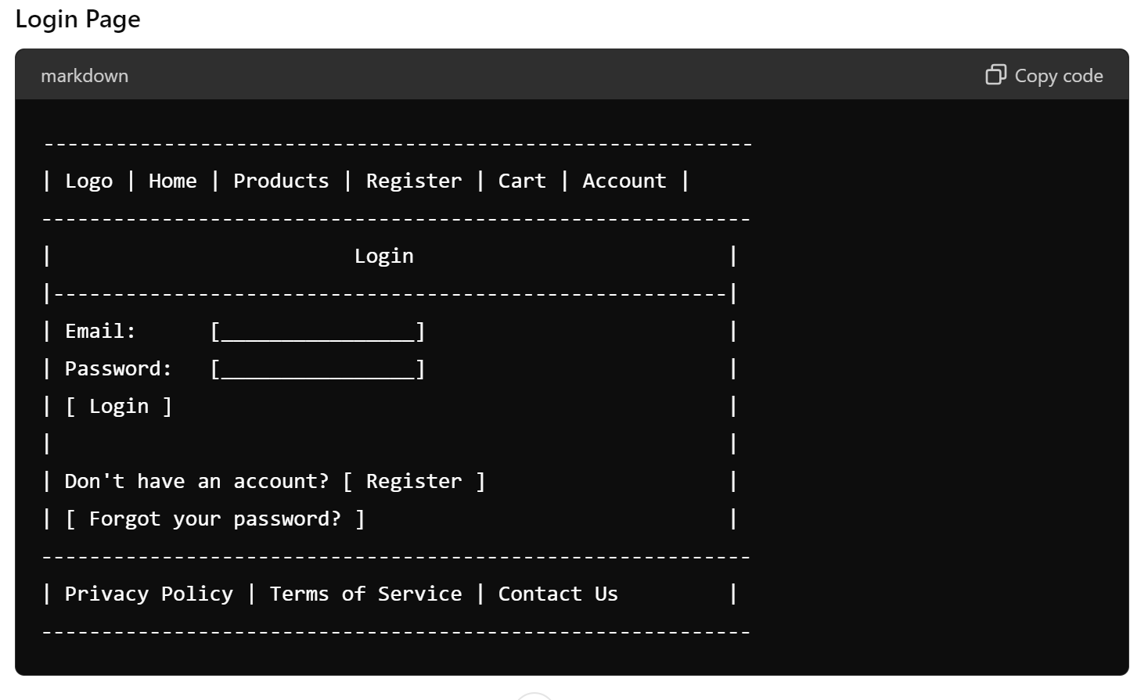

Slide 14
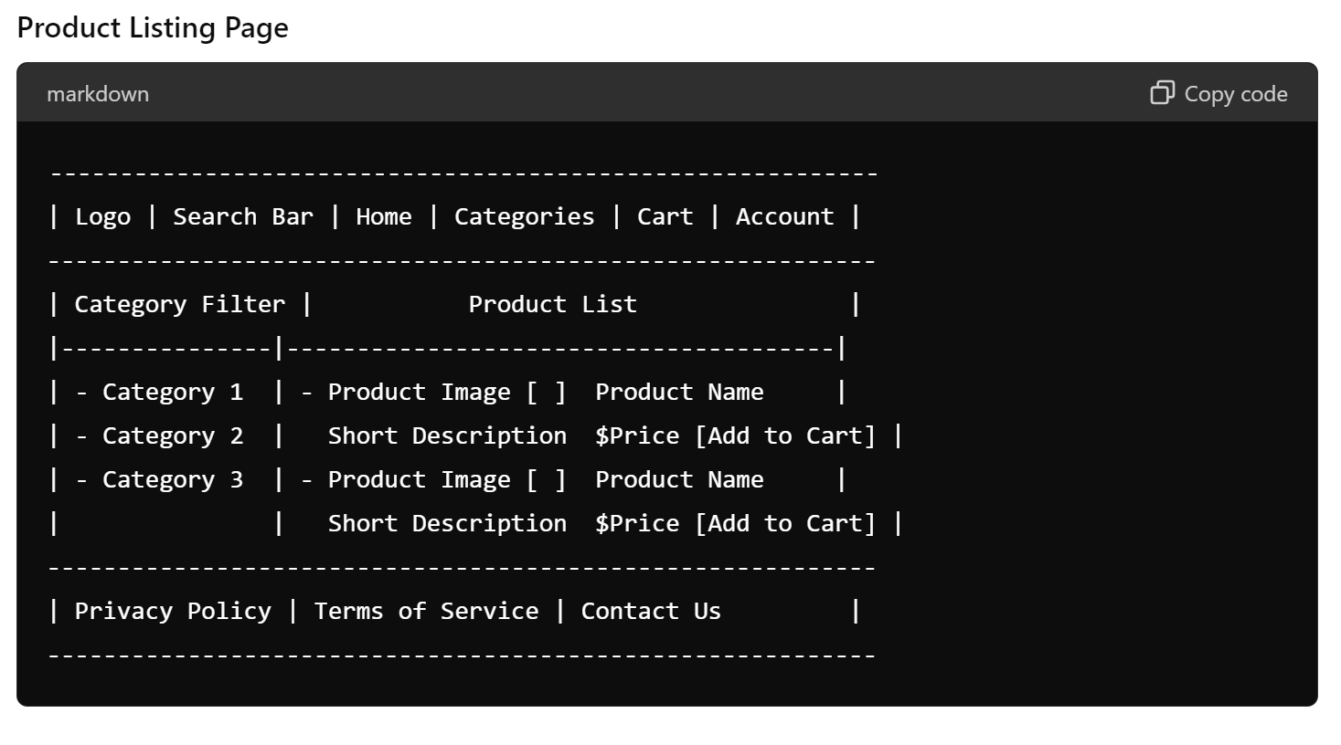
2. Product Catalog Management

Slide 15
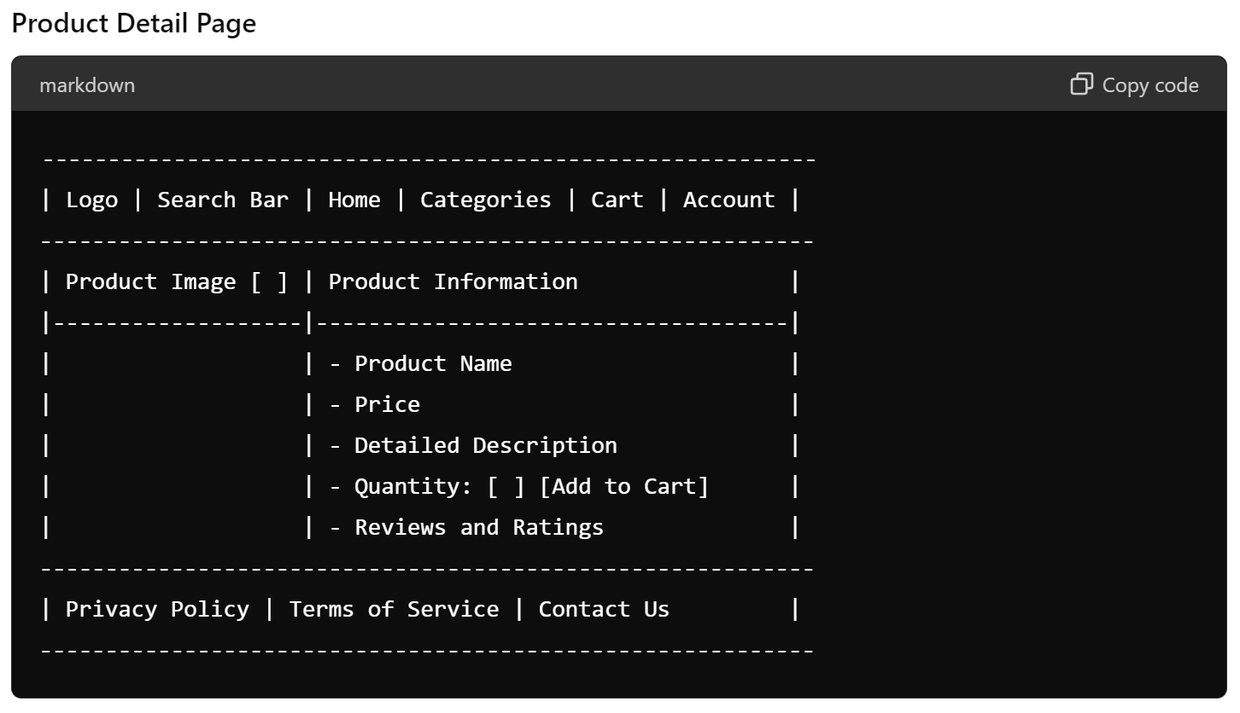

Slide 16
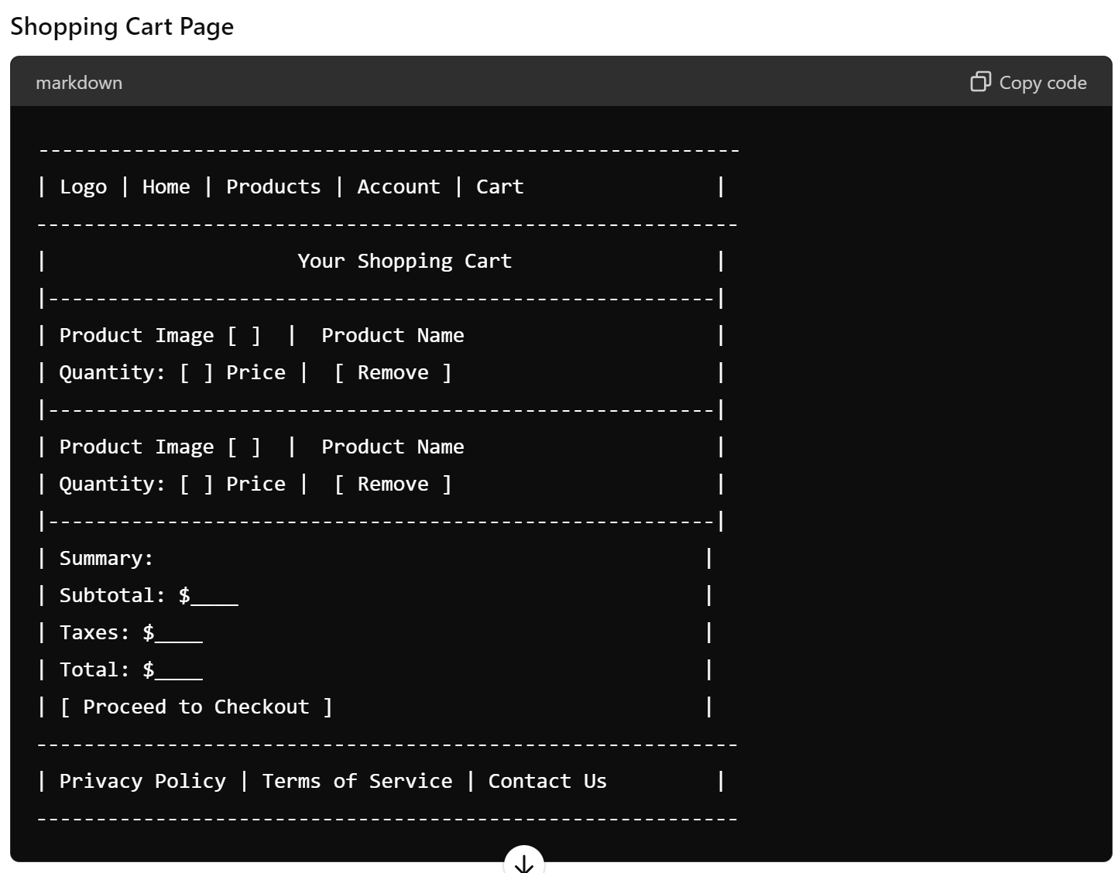
3. Shopping Cart

Slide 17
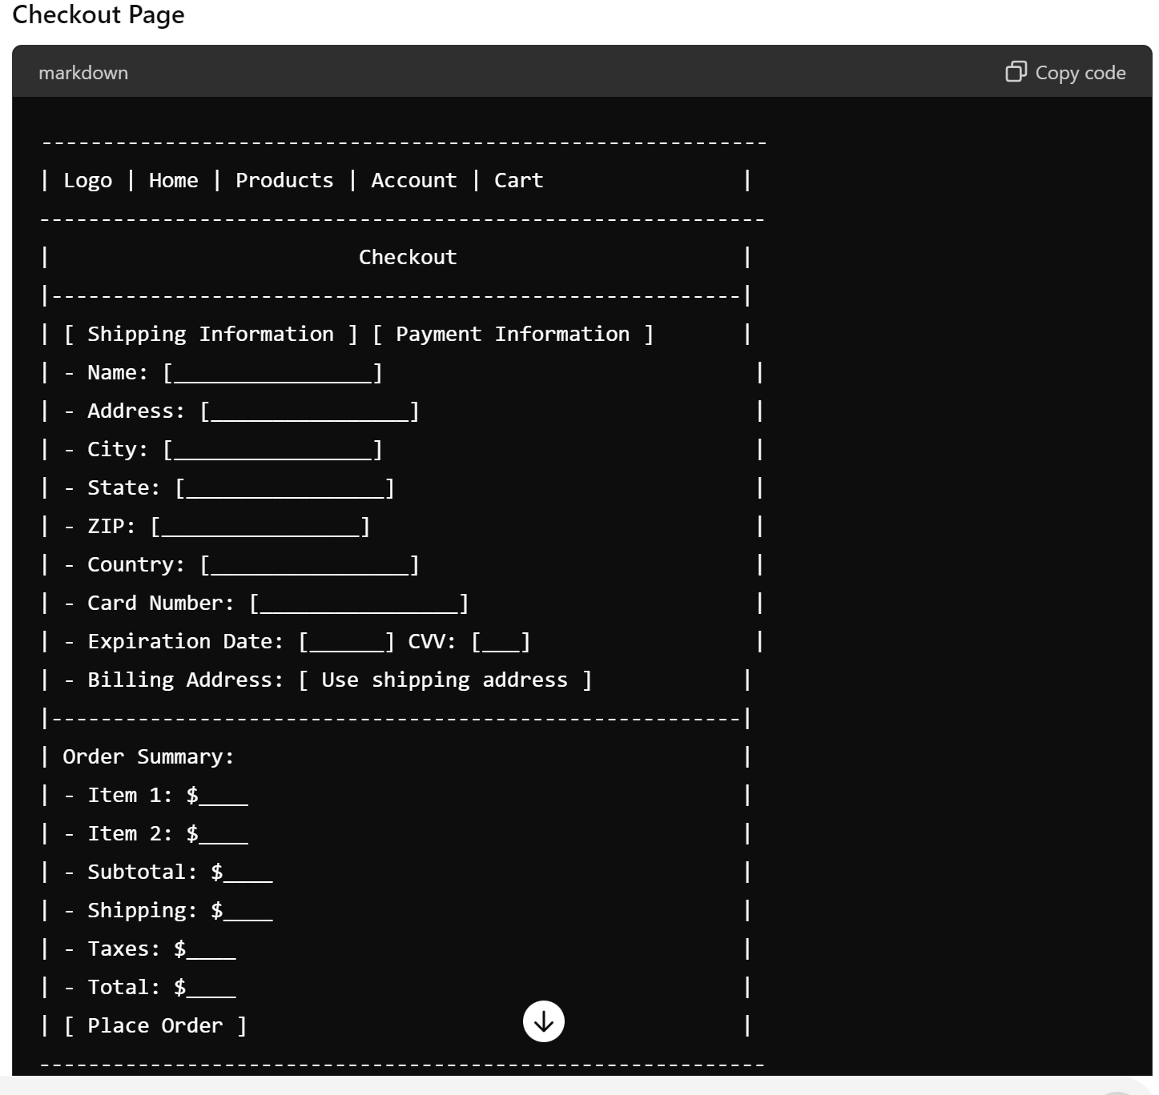
4. Checkout Process

Slide 18
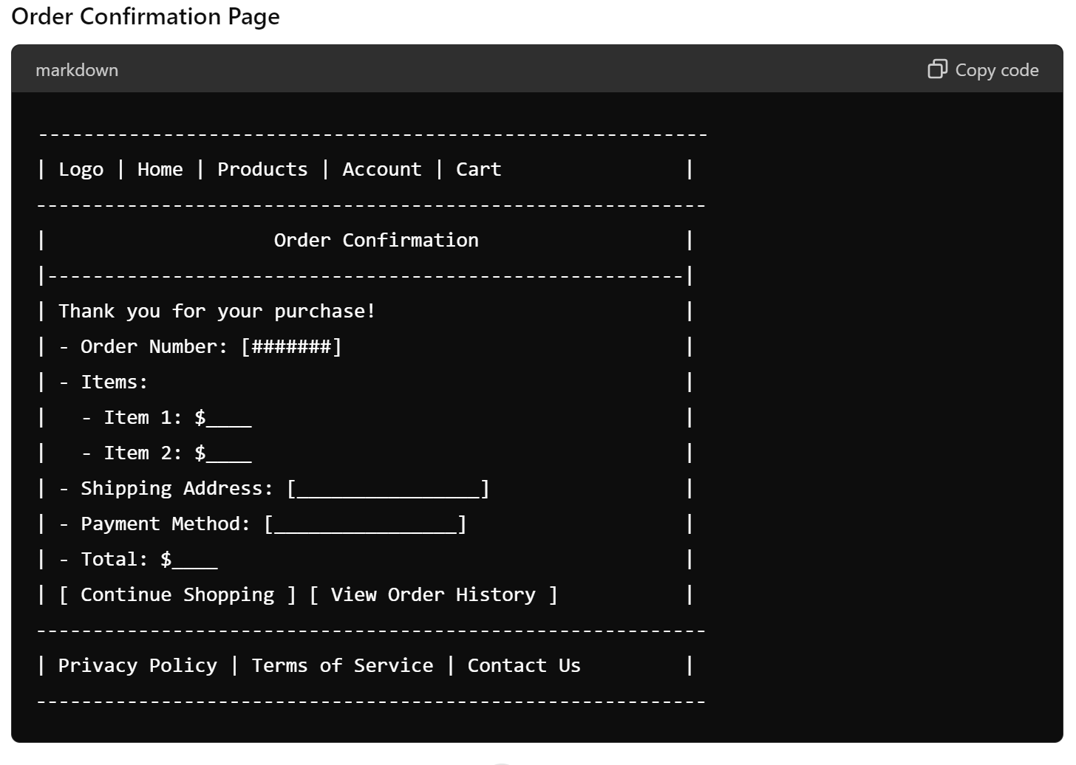
5. Order Management

Slide 19
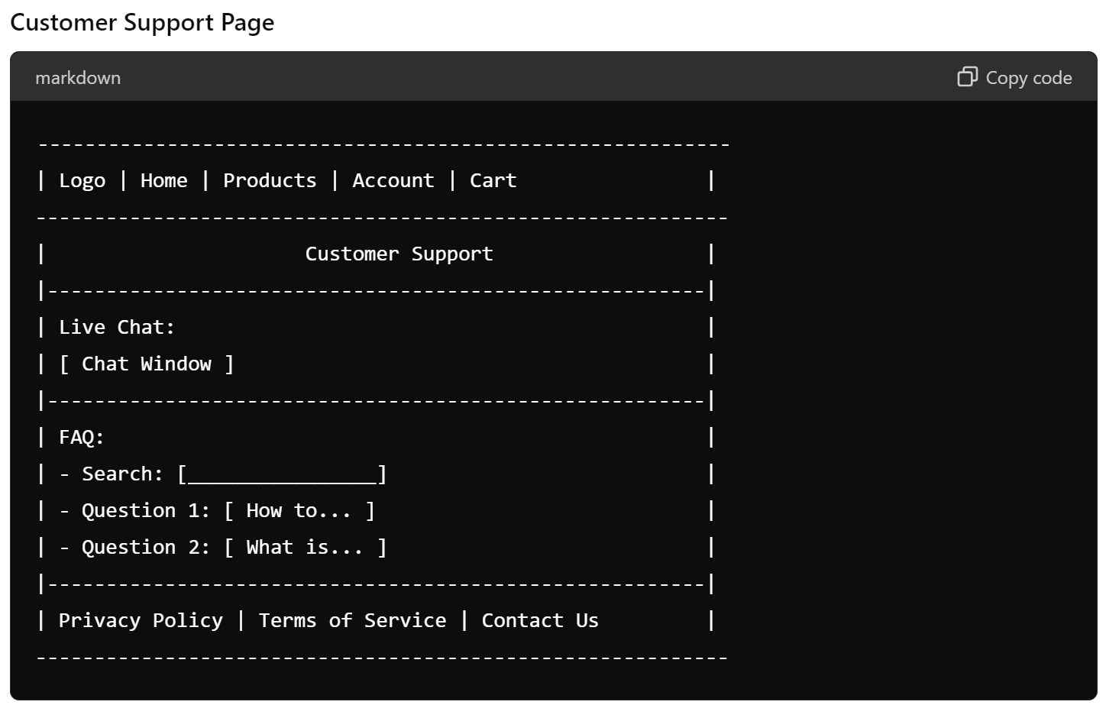
6. Customer Support

